Slide 1
Dancing Dogs
Sean Song
Lily Young
Sandra Tiu Latt

Slide 2
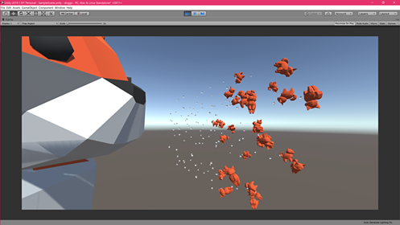
Overview: Two dogs barking to the music

Slide 3
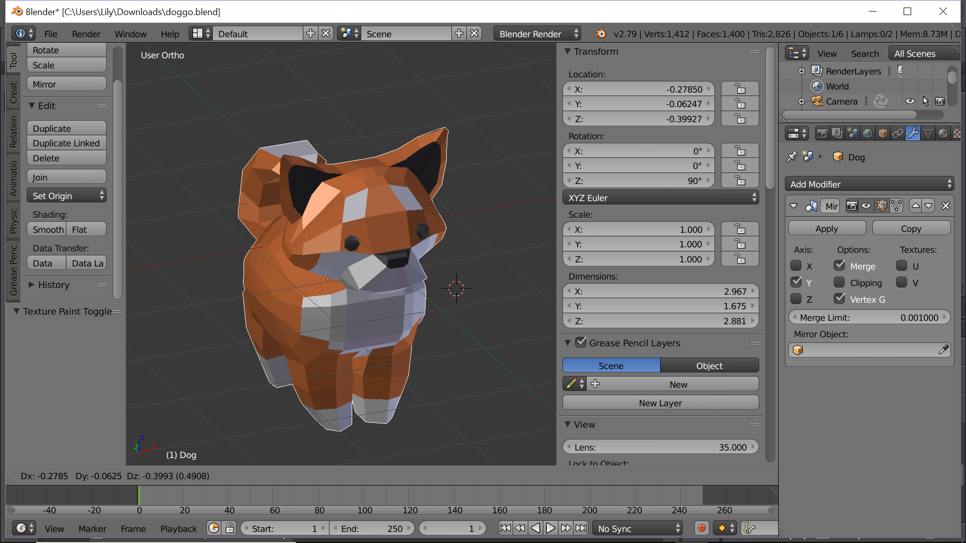
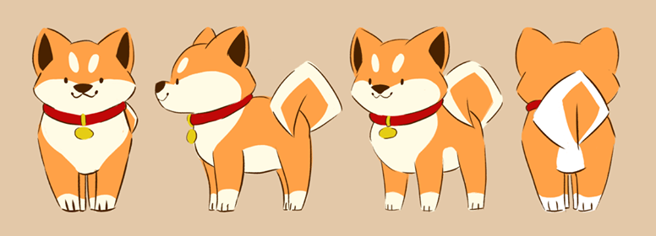
Dog Model

Slide 4
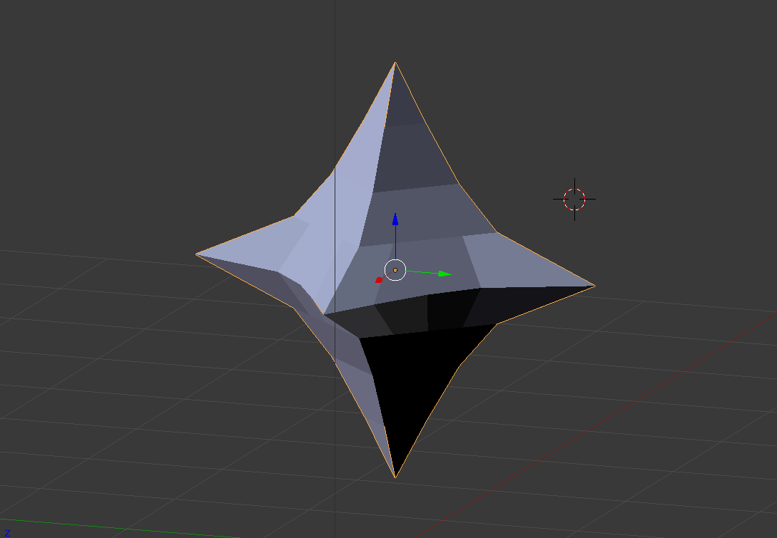
Sparkles

Slide 5
In-progress
toon shading on the models
bloom effect on dog eyes / sparklies
audio implementation
animate the mouth to bark
Disco floor

Slide 6
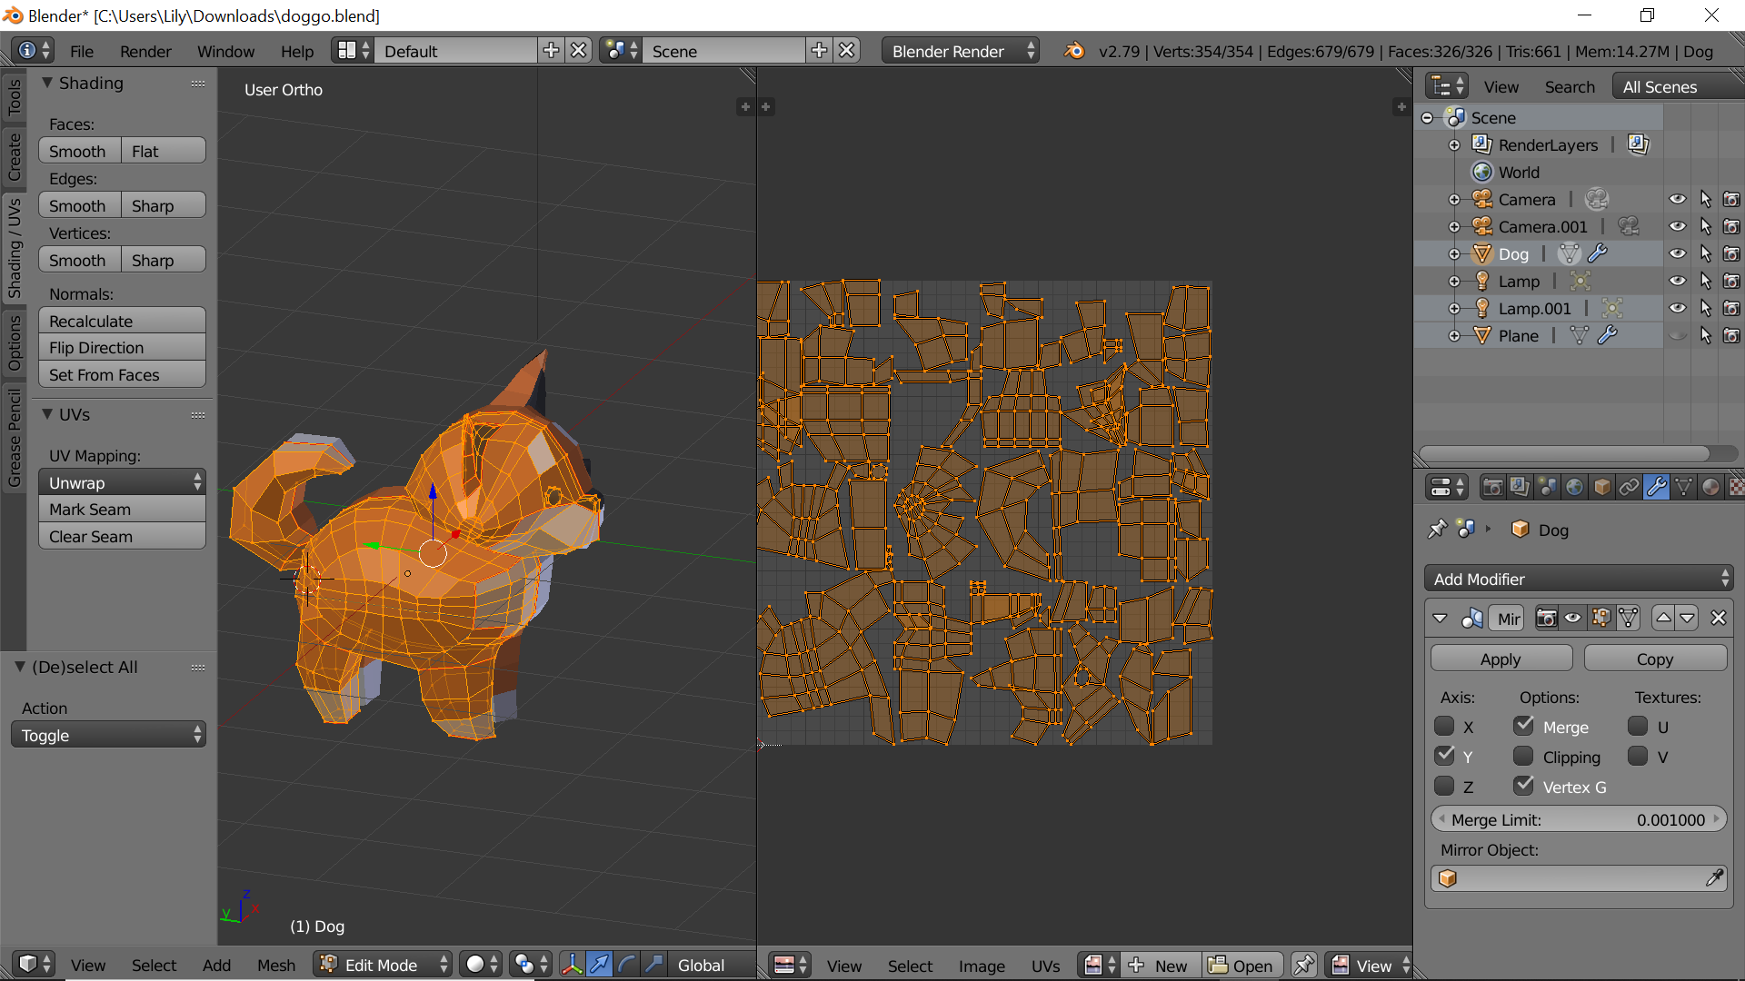
In-progress: Texturing

Slide 7
Thank you!

